Slide 1
L08 – Non-functional requirements
FIT2101: Software Engineering Process and Management
S2 2018

Slide 2
In this lecture…

Slide 3
Summary

Slide 4
Next lecture

Slide 5
In this lecture…
Requirements that are hard to manage
Eliciting requirements revisited

Slide 6
Requirements
Today’s lecture is about requirements.
We have seen requirements before, and seen how they can be managed:
elicit from client or product owner
written down as user stories
stored in a backlog until completed
acceptance tested
Today, we will look at requirements that are hard to manage, for example:
can’t be elicited easily
hard to phrase as a user story
hard to manage using a backlog
hard to test or verify

Slide 7
Usability
Some tools are easy to use. We want the software we create to be easy to use, so that it enables our users to achieve their goals with ease.

Slide 8
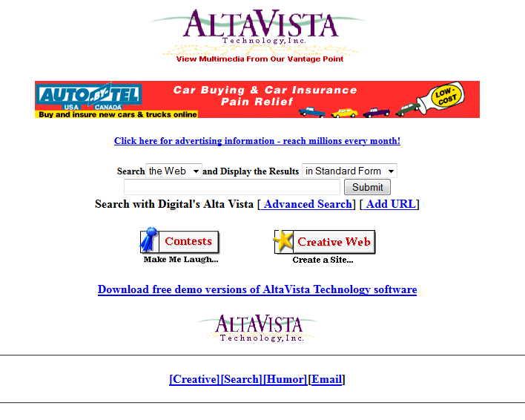
altavista.com
It’s 1996. Some people in Palo Alto have invented a new thing called a “search engine”. Cool!
Notes:
I think this whole World Wide Web thing is just a flash in the pan – it’ll never take off.

Slide 9
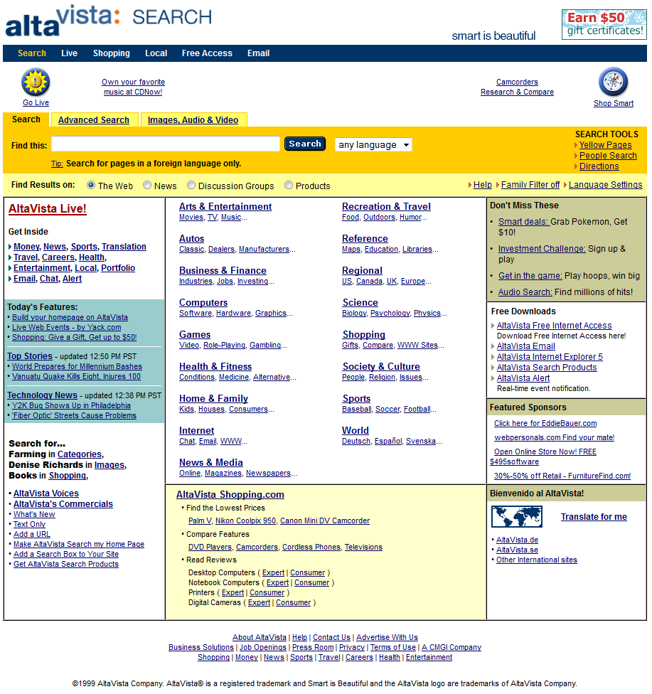
In 1998 they became a “portal site”: lots more content.
Unfortunately, something else happened in 1998…

Slide 10
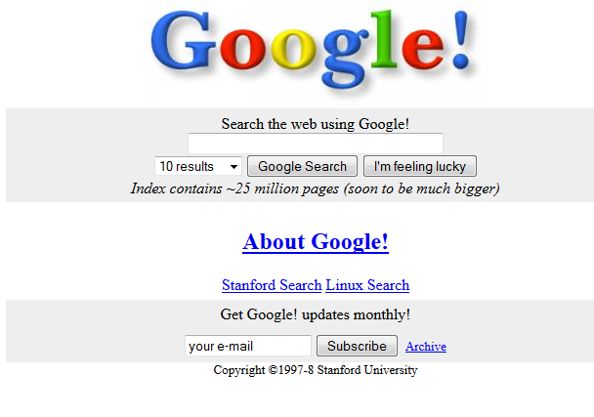
Google’s user interface started simple…
Notes:
At this point I stopped using altavista. The UI was just too annoying.

Slide 11
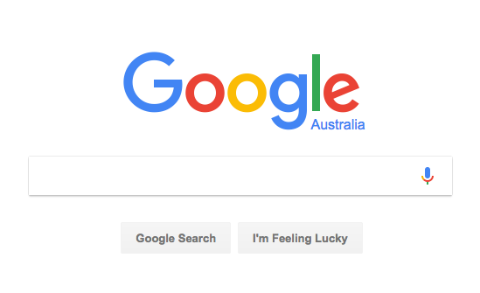
…and it stayed simple.
in fact it got simpler.
Notes:
When was the last time you heard of anyone “altavista-ing” something?

Slide 12
What did AltaVista do wrong?
Many things in the business and technical sphere, but let’s confine ourselves to their UI design
Was AltaVista’s site still capable of being used?
yes: there’s still a search box is at the top of the page
so desired functionality was still being provided
So why did people like Google’s offering better?
because it had fewer options, so it was easier to find the right one
AltaVista’s design changes were driven by marketing
people wanted search, not a product directory or a lot of advertising
Notes:
Larry Page and Sergei Brin took their PageRank algorithm to AltaVista. AltaVista turned them down, so they started their own company: Google.

Slide 13
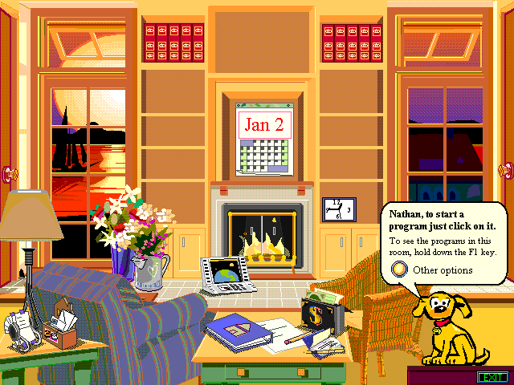
Microsoft Bob
Notes:
This wasn’t a game – this was the primary OS user interface, equivalent to Windows Explorer in today’s OS.

Slide 14
What’s wrong with Bob?
Lots of stuff on the screen
Not obvious what’s a control (or a program launcher) and what’s just decoration
Required high-spec hardware (for the time)
typically wouldn’t find in the home
Notes:
Not exactly the sort of user interface one would normally expect to find on an office PC, and yet it required a high-end machine that was beyond the reach of what appeared to be MS Bob’s target audience. Bob appeared not to know who it had been written for.

Slide 15
Why did Microsoft get it wrong?
They thought that home users were confused by the desktop metaphor
So they thought they would fix this by providing a different metaphor
instead of files and folders on a desk, your environment was a virtual room

Slide 16
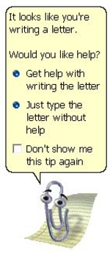
Clippy
Notes:
One of the most aggravating pieces of software ever.
Not written by stupid people, far from it – the MS Office Assistant was based on sophisticated Bayesian AI algorithms to detect when the user was likely to strike trouble and offer appropriate advice.

Slide 17
People hated Clippy
Clippy – Microsoft’s Digital Assistant – was widely detested when it as released as part of Microsoft Office in 1996
Microsoft focus-tested Clippy and other digital assistants before release, and the focus groups didn’t like them
they were included in the release anyway as the team were convinced that users would love them
The Digital Assistants were aimed at novice users
Most people using Word were professionals, doing it at work
As a professional, it’s annoying when anybody interrupts you when you’re working
especially when they go on to patronizingly offer to show you how to do something as basic as typing a letter!

Slide 18
Why is usability hard?
Many reasons
stakeholders want their software to be usable, but usually don’t know what that would look like
different stakeholders have competing needs, so it’s hard to get consensus
how do you put usability into user story form?
or in use cases, for that matter – traditional methodologies don’t help here
how do you acceptance-test for usability?
how much are clients or purchasers willing to pay for it?
If your stakeholders can tell you exactly what they need you to build, you can probably build it
but they have to be able to foresee where usability problems might lie
and they have to be able to come up with workarounds
besides, you’re supposed to be the expert here!
Many other types of requirements suffer from similar problems

Slide 19
Requirements can be hard to pin down
Usually, your stakeholders will have a pretty good idea of what they want the software to do
even if they don’t know how that will be implemented
Much harder to put your finger on aspects of the software that end-users can’t see
properties of a software system that arise from the way that its components interact
or from the way that the system interacts with the outside world

Slide 20
Functional requirements
The functional requirements of a software system are the requirements that tell us what the software is supposed to do
specify the behaviour of the system given particular circumstances and inputs
given inputs A, B, C, the software should compute D
these are usually fairly easy to translate into user stories/use cases
testing might be cumbersome, but is usually straightforward
So far, most of the requirements you have seen have been functional requirements
Notes:
Define.

Slide 21
Non-functional requirements
NFRs for short
Also called quality attributes, quality goals, non-behavioural requirements
Usually properties of the system as a whole rather than of a single component
Notoriously difficult to get right
Notes:
Define.

Slide 22
Is usability really non-functional?
Arguably, yes: usability is a property that emerges from the system as a whole
interactions between components can strongly affect usability
Arguably, no: many aspects of usability can definitely be expressed in terms of functional requirements
Ultimately, it doesn’t matter what you label these tricky requirements
as long as you are aware that they need to be discussed
and you manage them well
and you satisfy them with the software you build
We will continue to refer to them as NFRs, even though they may have functional aspects
we’ll be concentrating on those other aspects that make them hard to deal with
Notes:
Maybe yes, maybe no. What you call these requirements doesn’t matter. What matters is that you elicit them, and that you manage them in such a way as to come out the other end with good software.

Slide 23
Requirements elicitation revisited
One thing that makes many NFRs hard to deal with is that they may represent functionality that stakeholders don’t know they need
security is a classic example
as is resilience to DDOS
How do you go about eliciting requirements from people who aren’t consciously aware of them?
Notes:
The difficulty of NFRs is that they may represent functionality that users don’t know they want (such as security), or assume they’ll get (such as stability).

Slide 24
Asking stakeholders
Just because stakeholders can’t articulate all NFRs doesn’t mean they can’t articulate any
Can construct interview protocols and questionnaires to prompt them to think about qualities of the software that will be important
You’ll need to canvass widely – don’t assume that whoever’s paying the bills is the only person worth listening to
e.g. try to talk to the people who will deploy and maintain the software as well as the people who will use it
doing a good job of stakeholder mapping gives you a good place to start when deciding who to speak to
Notes:
This is obvious – stakeholders can’t always articulate all NFRs, but they can usually articulate some. You can construct questionnaires to prompt them to think about others.

Slide 25
Try-and-see
If the NFR involves visible system behaviour, you might be able to clarify it using iterative design and focus testing
produce a prototype that people can use and get feedback from authentic users as soon as possible
For some NFRs, such as supportability and auditability, you might need to do a staged rollout
do an initial, limited deployment (e.g. only to some users) and see how well support/operations staff are able to manage it
take their feedback into account when designing the next iteration/release
What you are doing here is building an opportunity for end-user feedback into your release management
Notes:
If the NFR involves visible system behaviour, such as usability, might be able to do iterative design via focus test/usability test.
For some NFRs, such as supportability and auditability, you might need to do a limited initial rollout and see how it goes, then a later full rollout including lessons learned from trying to support the initial version.

Slide 26
Domain knowledge
A domain, in this sense is a sphere of knowledge
the domain of a project is the business or activity it supports, e.g. education, public administration, finance, games
As you develop experience with writing software in a particular domain, you’ll begin to get a sense of where the risks and hidden requirements are likely to lie
You can use this knowledge to help you find NFRs
Consider whether problems that arose in your previous projects might reoccur in your new project
e.g. if your previous project was taken down by hackers, you’ll know that you need to consider DDOS protection for this one
This is one reason that job ads often ask for experience in a particular domain, e.g. “5 years’ experience in manufacturing”.
Notes:
There is no substitute for experience when it comes to understanding NFRs. If you’ve worked within this domain before, you’ll know about some of the likely perils and pitfalls of development.

Slide 27
Hire an expert
For some kinds of NFRs, you’ll almost certainly need help from outside your team
For example, if your software needs legal compliance, i.e. there are laws that govern what it may do, it would be wise to hire a lawyer
sometimes laws are straightforward but if there’s any interpretation required you’ll need an expert
Security is another example
start by building the system to be as secure as you can manage
then hire a penetration tester to find gaps in your security

Slide 28
Summary
Usability
Non-functional requirements
Eliciting NFRs

Slide 29
Next lecture
Deployment, post-deployment, and DevOps

